Slide 1
Paren
Matching STUDENTS with THEIR best chance of employment

Slide 2
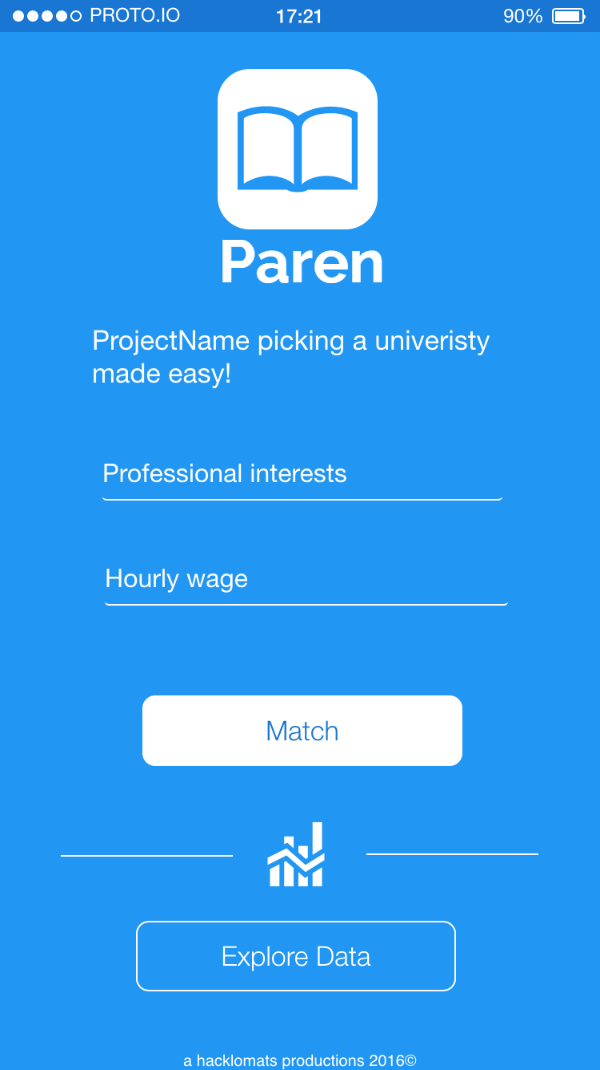
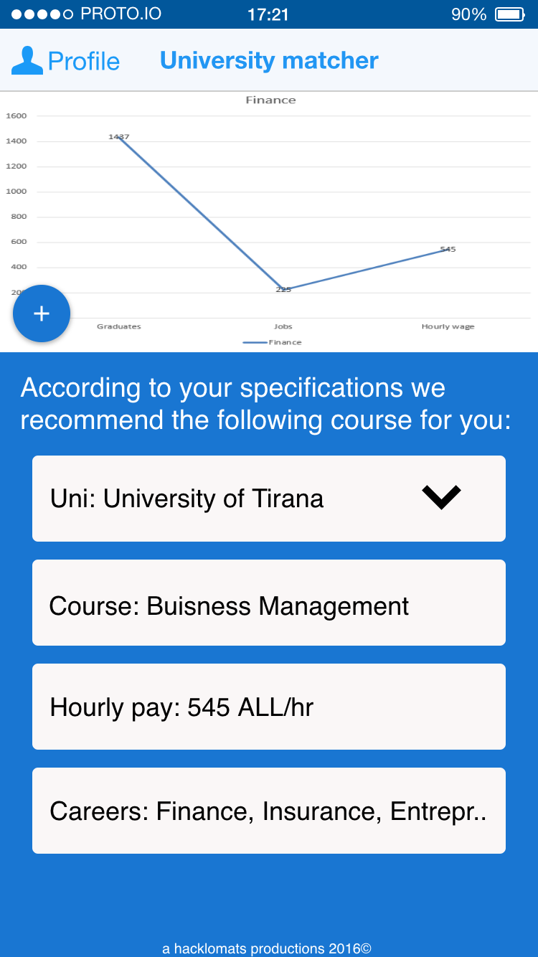
Paren! Makes choosing a university easy
Makes choosing a University easy

Slide 3
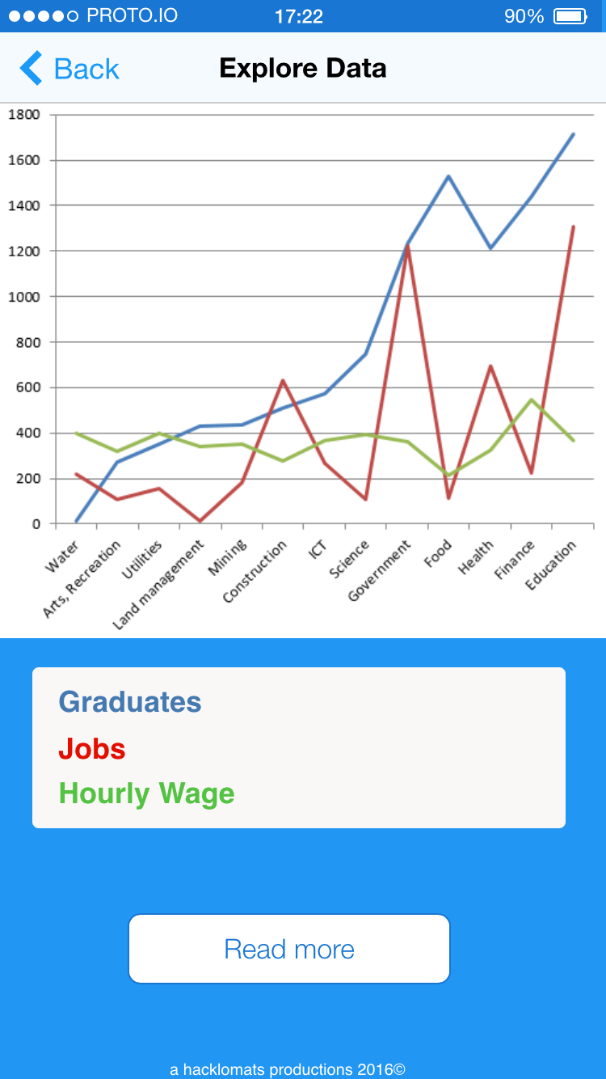
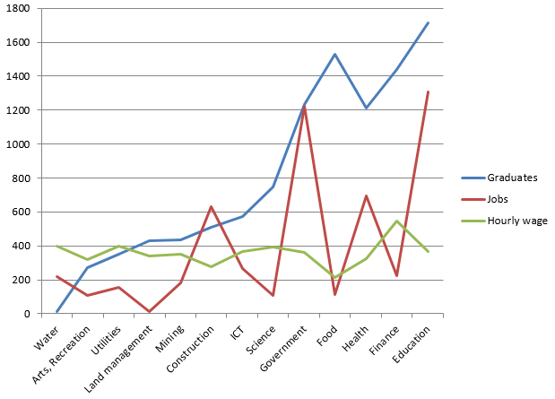
The Data behind Paren

Slide 4
Paren
Thank you!

