Slide 1
Sunshine Pirates
Team:
Luçiana Fani
Elinda Guri
Ylldise Brahimi
Mirton Resuli

Slide 2
Last years in Albania, and not only, is increasing the number of families…

Slide 3
…with just one member!

Slide 4
According to INSTAT, there are almost 6000 families with one member! Not considering those who are not declared as living alone…

Slide 5
For this reason, this target group needs…

Slide 6
The WANA App! (We are not alone!)

Slide 7
WANA integrates a mobile app and a smart bracelet with sensors.

Slide 8
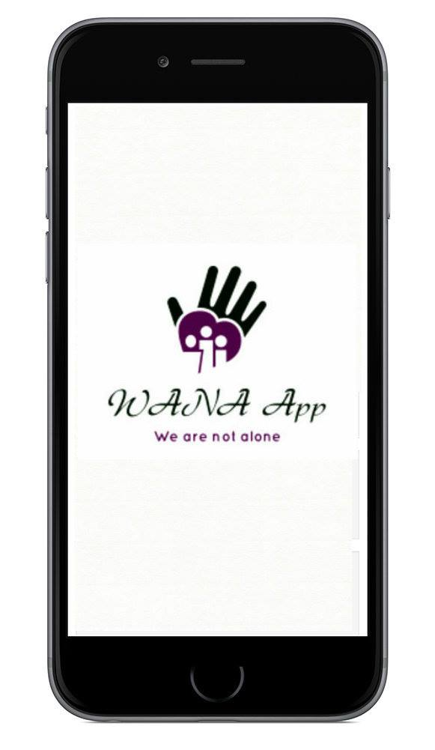
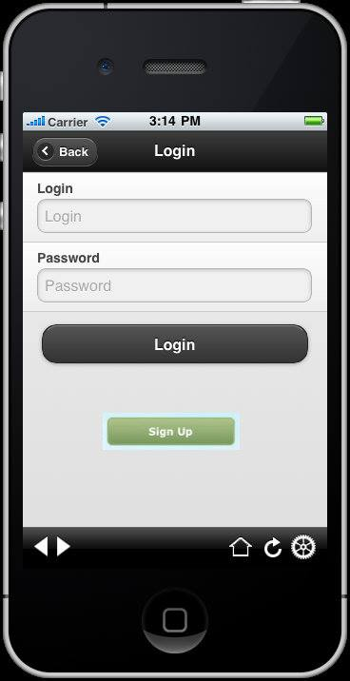
FIRST PAGE Login-Register

Slide 9
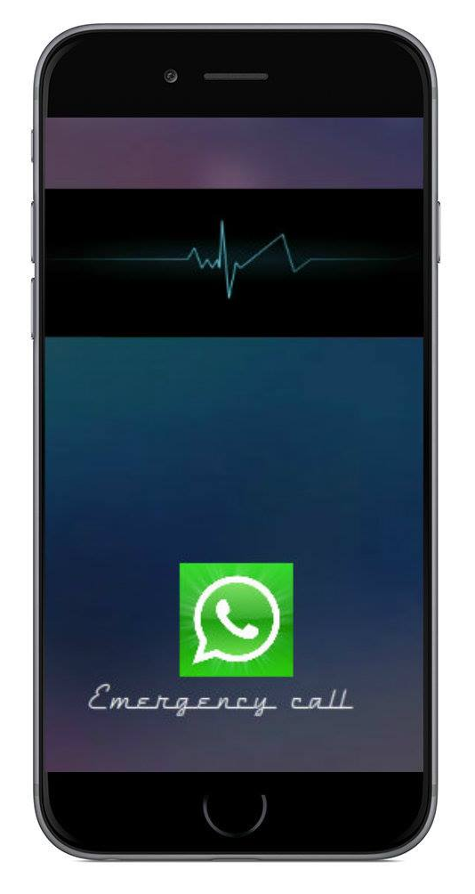
Emergency Call

Slide 10
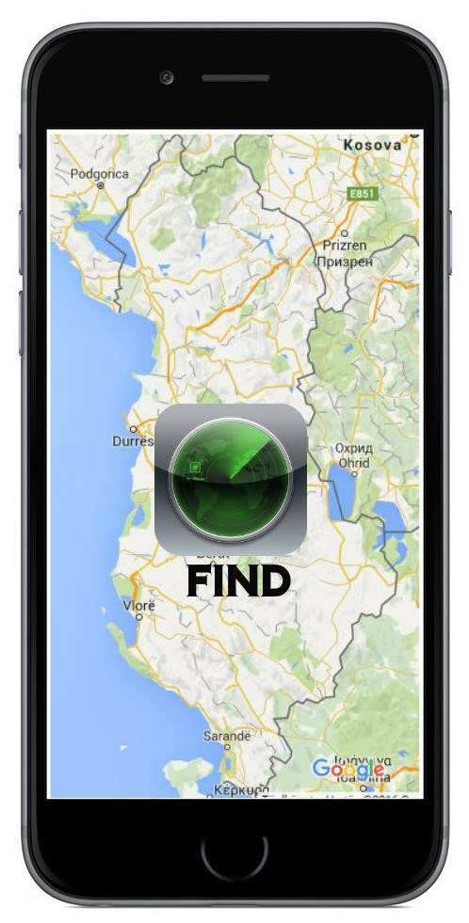
The Help

Slide 11
The role of Civil Society
Identify the stakeholders;
Awareness campaign;
Create network among different donors;
Managing and evaluating the process.

