Slide 1
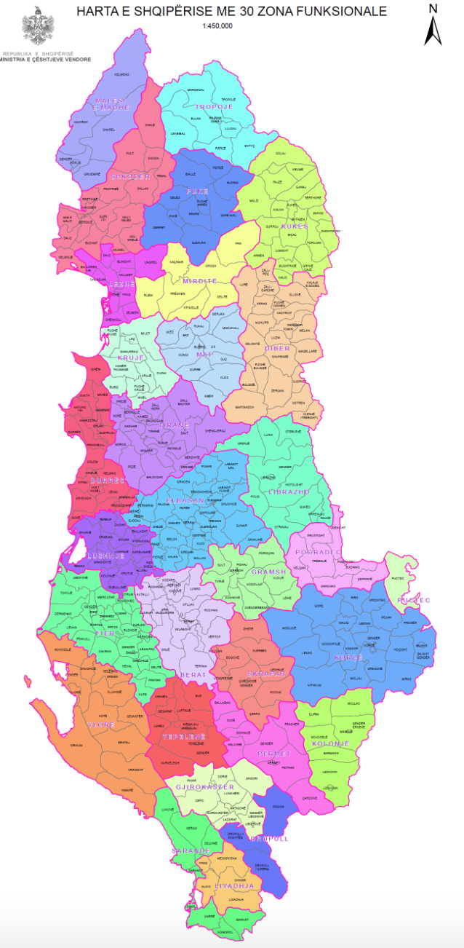
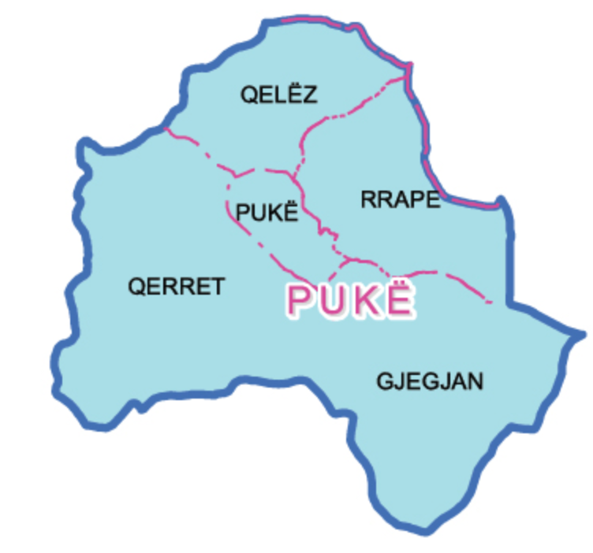
What is Puka?
Population: 11 069
Elevation: 890m
Area: 505.53 km²
How to get there?
Car, Bus , Walk
Why Puka?
Virgin nature
Hospitality
Traditional food
Historical and cultural attractions
Natural beauty
24 hours less than 24 euros

Slide 2
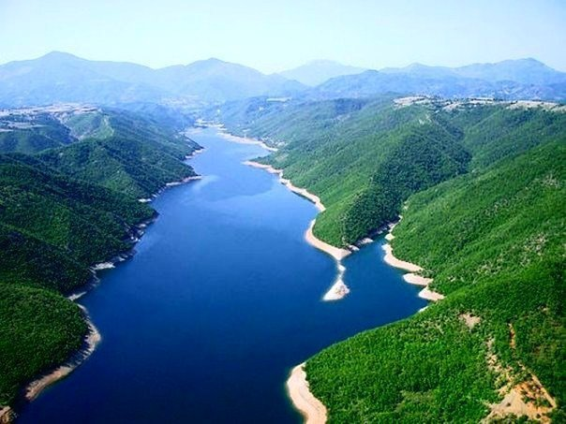
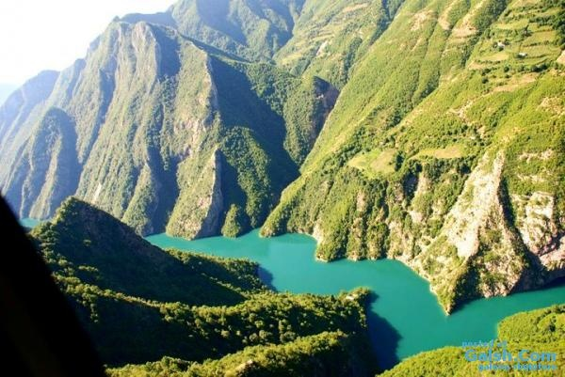
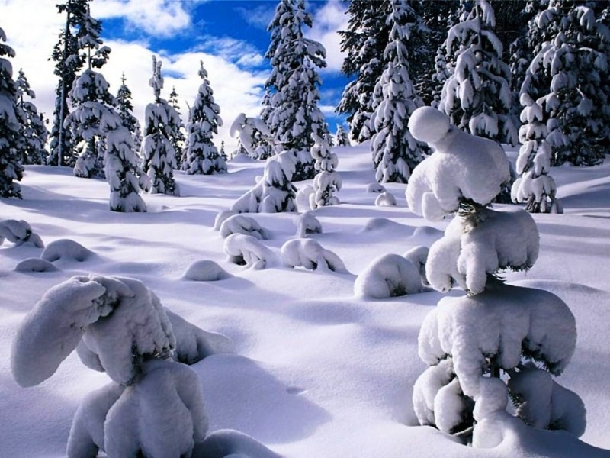
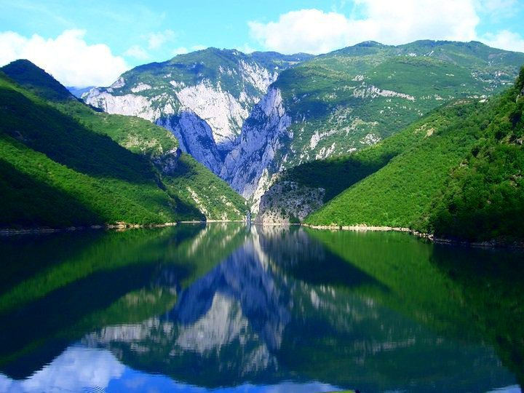
Archeological sites/ 3000 years of history
Very rich flora and fauna/ 20 flowers per 1 m²
Best chestnuts, truffle and wild mushrooms in Albania
Pre-alps area
Discovery the unknown Albania

