Slide 1
www.unepyes.al
DECS16

Slide 2
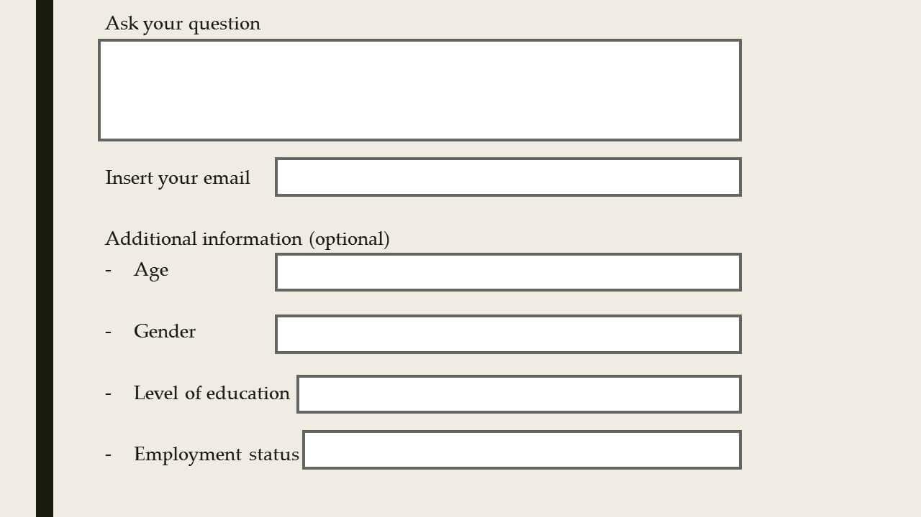
www.unepyes.al
DECS16

Slide 3
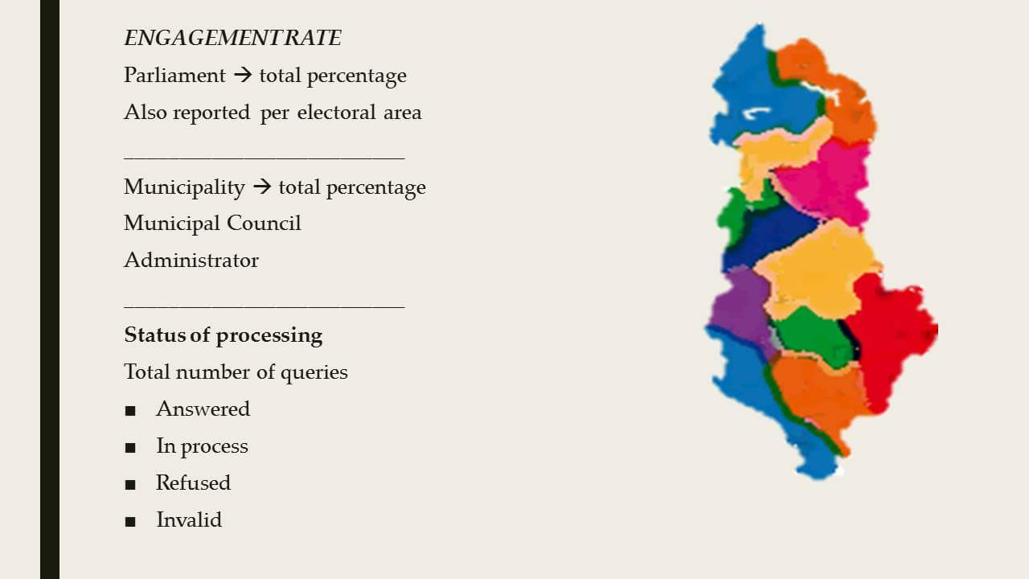
www.unepyes.al
DECS16

Slide 4
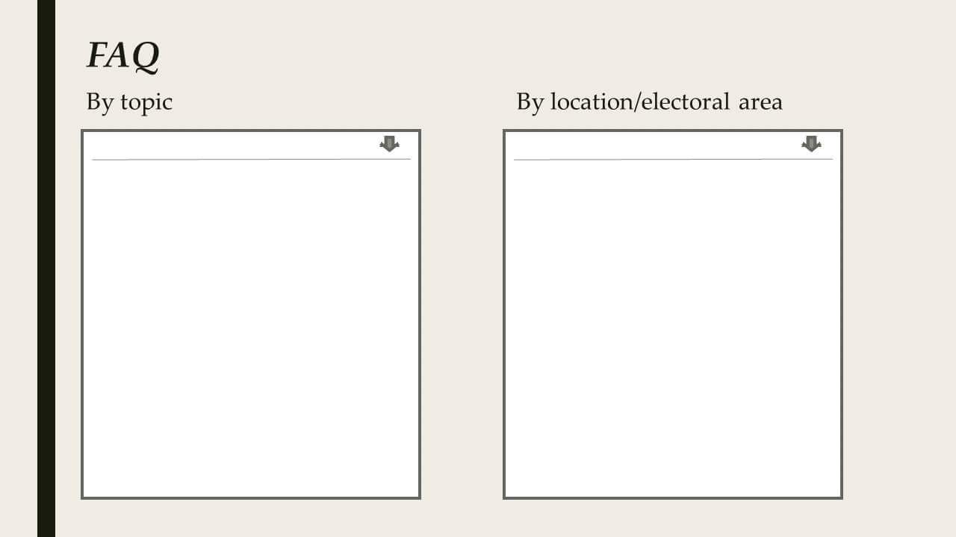
www.unepyes.al
DECS16

