Slide 1
Access Hack
by Love in Action

Slide 2
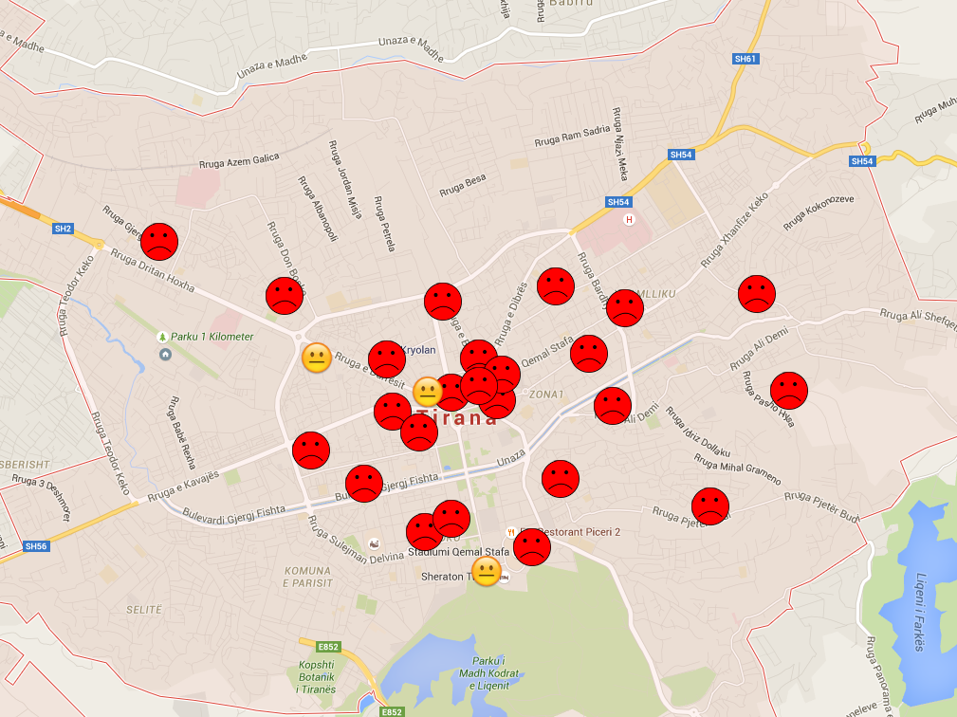

Slide 3
http://projects.websolutions.al/accesshack/

