Slide 1
Public Procurement in Montenegro
Ana Đurnić
Institute Alternative
July, 2016

Slide 2
Types of PP procedures
Open Procedure
Limited procedure
Negotiated procedure with publishing a call to tender
Negotiated procedure without publishing a call to tender
Competition
Shopping method
Direct Agreement

Slide 3
Institutional framework
Public Procurement Administration (PPA)
State Commission for the Control of Public Procurement Procedures
Inspection Directorate - Public procurement inspector
Administrative Court
Ministry of Finance
State Audit Institution

Slide 4
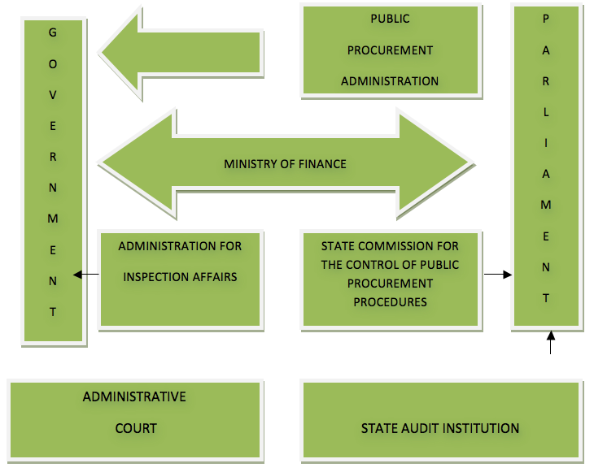
Institutional framework

Slide 5
Legislative framework
Amendments to the Public Procurement Law adopted in December 2014, entered into force in May 2015
Introduced obligation of publishing tender documentation on Public Procurement Portal
PPA establishes and maintains PP Portal (Article 19 of Public Procurement Law)

Slide 6
Public Procurement Portal(s)
Two Portals
Old one
New, “innovated” one
Not interoperated, being used simultaneously

Slide 7
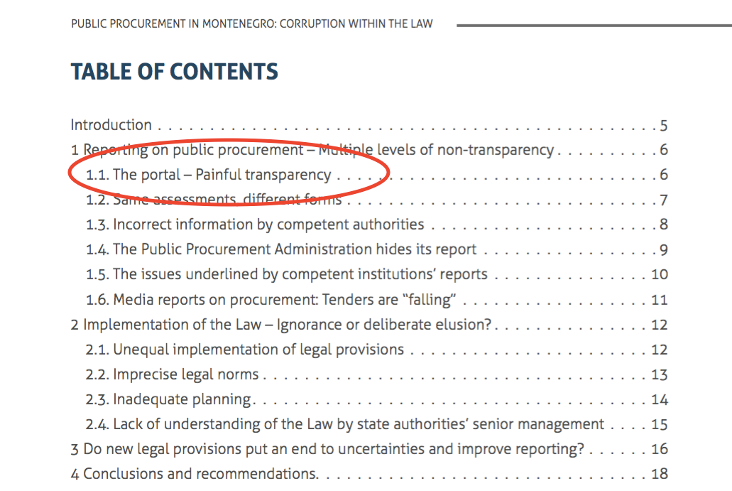

Slide 8
Old PP Portal
Contains data on PP conducted in a period 2012-2015:
Public procurement plans;
Decision on candidates’ competencies;
Decision on the selection of the best bid;
Decision on the termination of the public procurement procedure;
Decision on the annulment of the public procurement procedure; public procurement contracts;
Amendments to the plans, tender documents, decisions, and contracts.
The the Law does not prescribe the obligation to publish annual public procurement reports, and consequently the reports are not available at the portal.

Slide 9
Old PP Portal
Requires registration
Registries all visitors as bidders
List of all riders is being compiled based on data about visitors of the Portal
471 non - valid addresses at the Public Procurement Administration’s list of bidders

Slide 10
Old PP Portal
Data can be searched by subject, contracting authority and type of document, but not by bidders/service provider or contract registration number
Dates of contract conclusion and contract publication often do not match, and are sometimes very far apart
Search of a desired page is not possible, because each time the user wishes to resume the search they need to start from the beginning in order to come to the page they visited the previous time
The information is not sorted into categories but by publication date
Advanced search option exists, but the data found by using that option and by manual search (opening every page and every available/published piece of information) do not match
The file naming is inconsistent, which leads to the situation that the cumulative results found through advanced search are very unreliable

Slide 11
New PP Portal
Contains data from May 2015
Contains tender documentation
Does not require registration
No other improvement, compared to the old portal, problems remain the same

Slide 12
Incorrect information by competent authorities
Overall PPA’s annual report on PP
Individual reports on PP of contracting authorities
Inconsistent reporting:
IA assessed the degree to which the information provided in 2014 by contracting authorities diverged from the ones published by the PPA in its annual report by looking at a sample of 51 contracting authorities
Result: 24/51 procurement reports contain irregularities
Irregularities mostly referred to data on planed and completed budget and percentage of use of direct agreement (the least transparent procedure

Slide 13
Incorrect information by competent authorities and PPA
Four cases where none of the reports - the ones of contracting authorities nor the Public Procurement Administration’s Report contain correct data.
Ministry of Interior, Ministry of Economy, Ministry of Agriculture and Rural Development and Ministry of Human and Minority Rights.

Slide 14
IA recommendations for improving transparency of PP
IA presented recommendations for better reporting on public procurement
Public Procurement Administration conceals contracting authorities’ misdemeanours
Public Procurement in Montenegro: Corruption within the law

Slide 15
Q&A

Slide 16
Thank you for attention!
www.institut-alternativa.org
ana@institut-alternativa.org

