Slide 1
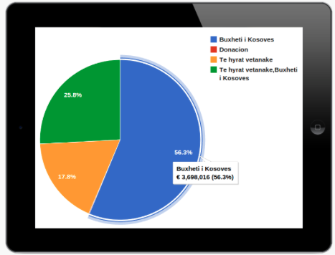
e-Prokurimi
Visualizing procurement data in Kosovo
e-prokurimi.org

Slide 2
The Problem
Lack of transperancy in the governmenal institutions
Lack of institutional accountability
Mismanagement of municial budget and donations
Difficult access and a lot of burecracy to get to the procurement data
Lack of an online platform where the citizens can have an easy access to procurement data
e-prokurimi.org

Slide 3
Mission
Creating innovative ways to display and publicize municipal procurement data and providing data to the public;
The creation of local tech community that will develop the online platform through which procurement data will be published for each municipality.
e-prokurimi.org

Slide 4
Municipalities
CLFI and UNDP
Agreement with 6 municipalities to open their data:
Prishtinë,
Gjakovë,
Ferizaj,
Gjilani,
Viti,
Hani i Elezit**

Slide 5
Open Data x Tech Community
Organizing workshops with students of engineering and computer science, in order:
Expose them to technologies used for analysis and visualization of data,
Train them in these technologies.
develop a platform technology www.e-prokurimi.org jointly with the local community.

Slide 6
Visualization of data by:
Budget type
Procurement type
Beneficiaries
Distribution in different periods of time.
Mapping of investment by region, investment value
and period,
Investment comparison among municipalities based on the value of the investment,
Number of tenders in a certain time period,
"Red Flags" algorithm for the detection of irregularities, misconduct during tendering of projects.

Slide 7
Number of Contacts, 2014

Slide 8
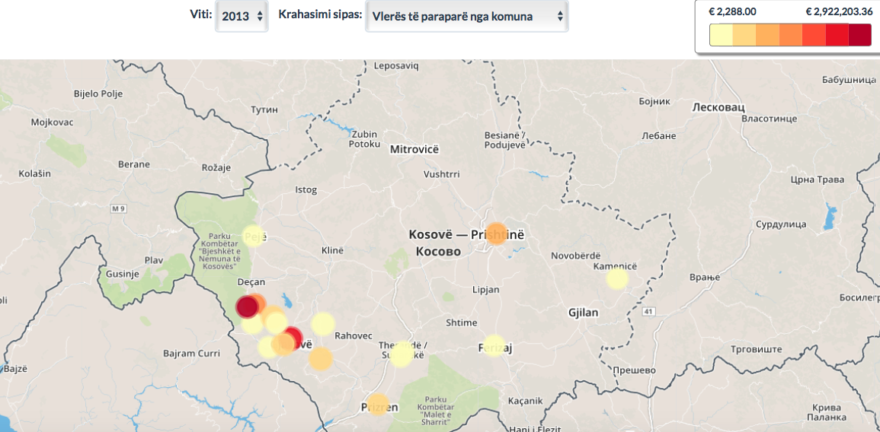
Mapping of investment by region

Slide 9
RED Flags
The site allows the detection (marking red) of suspicious tenders who meet one or more of the pre-set criteria.

Slide 10
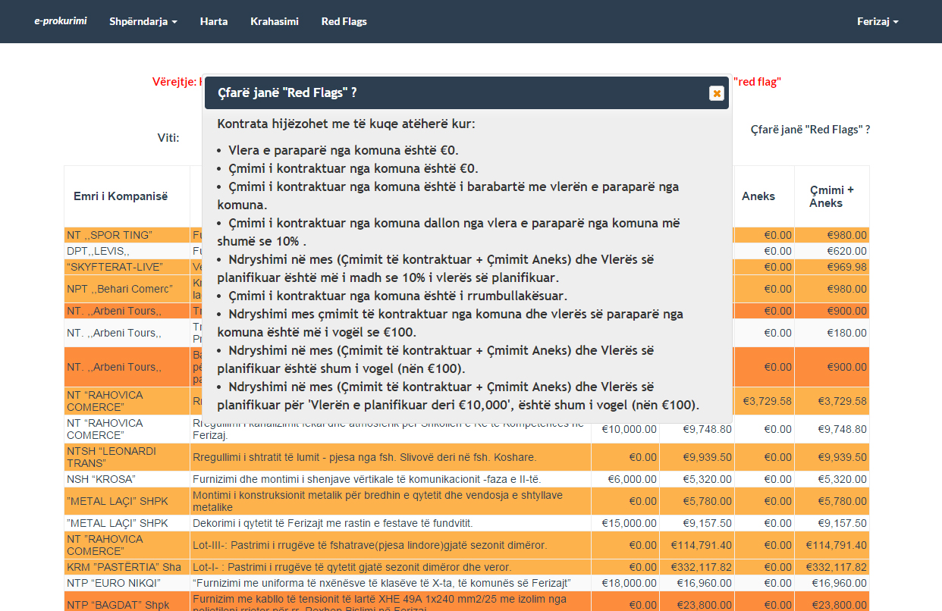
Red Flags

Slide 11
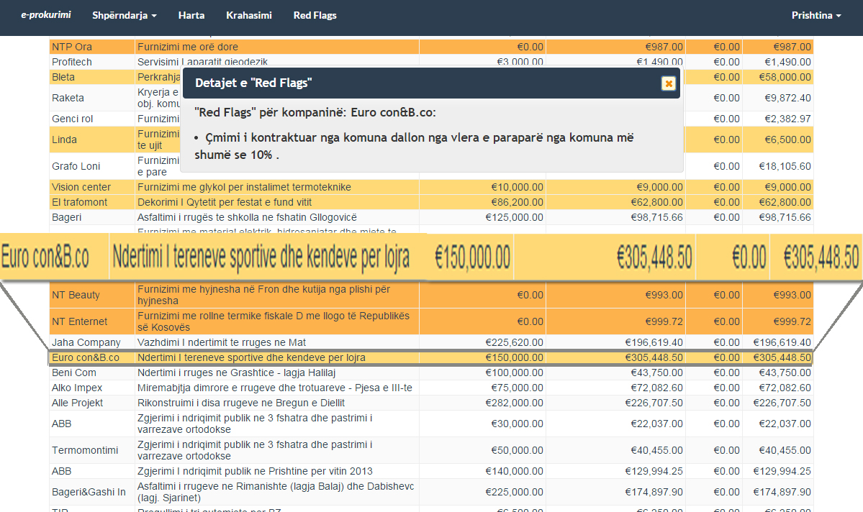
Red Flags

Slide 12
Red Flags

Slide 13
Problems, Challenges.
Missing Data
Inconsistent formatting of information
e.g. Prices: 5,000.00, 5.000.00
Dates: 19/07/2014, 19.07.2014

Slide 14
data.rks-gov.org

Slide 15
Thank you!
Stay in touch!
www.opendatakosovo.org
e-prokurimi.org

